Slide 1
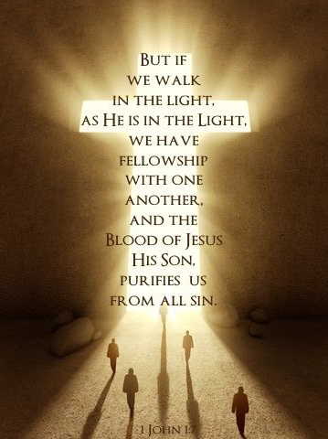
Walking with Jesus and your Holyrood Church on this Stations of the Cross
Prepared
Fr. Luis

Slide 2
At The Cross

Slide 3
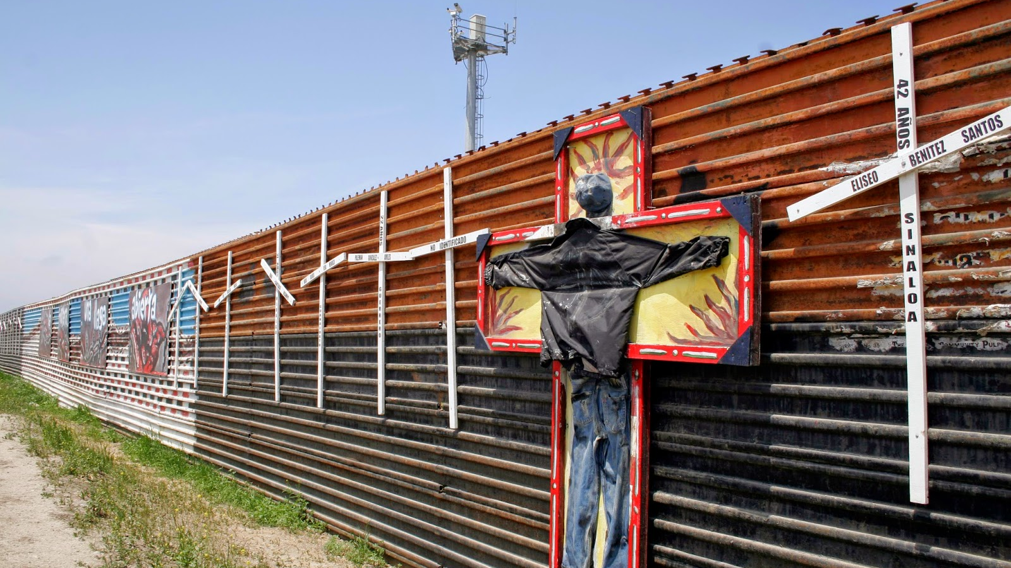
On the Stations of the Cross we walk with Jesus. If we walk with the people we will be walking with Jesus. This is the accompaniment discipleship to whom we were called. Faced with the death sentence imposed on the people, we must make a presence like Jesus.

Slide 4
Lent Prayer
Lord, Make me an instrument of your Peace.
Where there is hatred, let me sow love,
Where there is injury, pardon,
Where there is doubt, faith,
Where there is despair, hope,
Where there is darkness, light,
And where there is sadness, joy.
Oh Divine Master, grant that I may not so much
seek to be consoled as to console;
To be understood as to understand;
To be loved as to love;
For it is in giving that we receive;
It is in pardoning that we are pardoned;
Advertisement - Continue Reading Below
And it is in dying that we are born to eternal Life. Amen.

Slide 5
The memory of Jesus
If we were to visit the city of Jerusalem today, we could walk the path that Jesus took more than 2000 years ago; from the moment he was condemned to where he died and was buried. We could stop in our walk and see where he stopped and was whipped, where he fell, and finally where he was lifted up on the cross. This ancient prayer is called the Way of the Cross or Stations of the Cross and is our memory of the events of the last hours of Jesus' life. Documented as early as the 4th century, people remembered the incredible sadness, pain, and love that Jesus led to his death. . . where he died for us.

Slide 6
Jesus is always with us…
Walking the Way of the Cross in prayer is important because it is the same journey that each one of us walks throughout our lives. As Christian people we face pain, sadness, and love at all times. Being a Christian and following Jesus does not mean that we will not face difficult times or that we will not have our own cross to carry but that we will have the strength and help to do so.

Slide 7
Listern to the voice of God
As you live this experience through this prayer today, we invite you to listen and meditate on what is happening. Let’s accompany Jesus in his walk and stops where he stopped while exhausted, he walked painfully towards his death. Imagine what it was like for those people who lived this journey and try to feel what they might have felt. But above all, listen to what the voice of God is saying to you as you participate and walk this Way of the Cross that you will never forget.

Slide 8
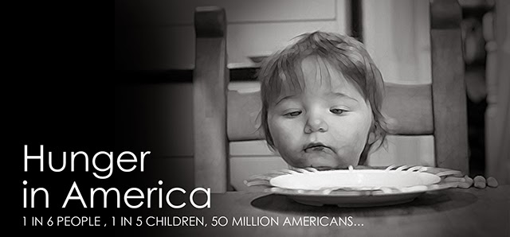
First Station: Jesus is Condemned to Dead. 1 in 6 people, 1 in 5 children, 50 millions of USA people.

Slide 9
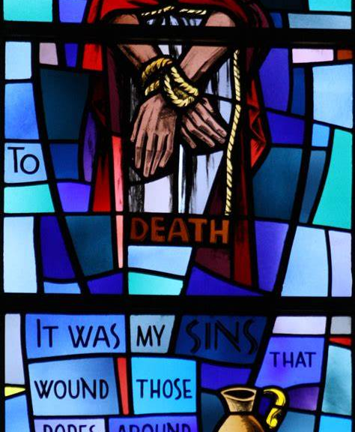
Guide: We adore you O Christ and we praise you,
All: Because by your holy Cross you have redeemed the world.
From the Gospel according to Matthew 27:22-23,26:
Pilate said to them, "Then what should I do with Jesus who is called the Messiah?" All of them said, "Let him be crucified!" Then he asked, "Why, what evil has he done?" But they shouted all the more, "Let him be crucified!" So he released Barabbas for them; and after flogging Jesus, he handed him over to be crucified.

Slide 10
What do people all over the world spend most of their time and energy doing? What are the barest necessities of life? Food, shelter and clothing. We spend most of our waking hours working to obtain these necessities. But of them all, food is the most important. Physical hunger is so consuming that we cannot think of anything else until it is satisfied.
Therefore, another way to continue condemning Jesus to death today is through hunger. There is an erroneous distribution of the resources that God created. Few people have a lot, and many others suffer because they do not have something to eat.

Slide 11
Questions to contemplate:
Why did Pilate offer to release Jesus?
Why did the crowd choose Barabbas?
Why did Pontius Pilate condemn Jesus to death?
Have you ever acted like Pilate?
Have you ever acted like the crowd?
In what other ways do we sentence Jesus to death today?
How far am I practicing the sin of indifference?

Slide 12
Let’s pray:
Our Father, Who is in heaven, Holy is Your Name; Your kingdom come, Your will be done, on earth as it is in heaven. Give us this day our daily bread, and forgive us our sins, as we forgive those who sin against us; and lead us not into temptation, but deliver us from evil. Amen.

Slide 13
God of Mercy and Compassion

Slide 14
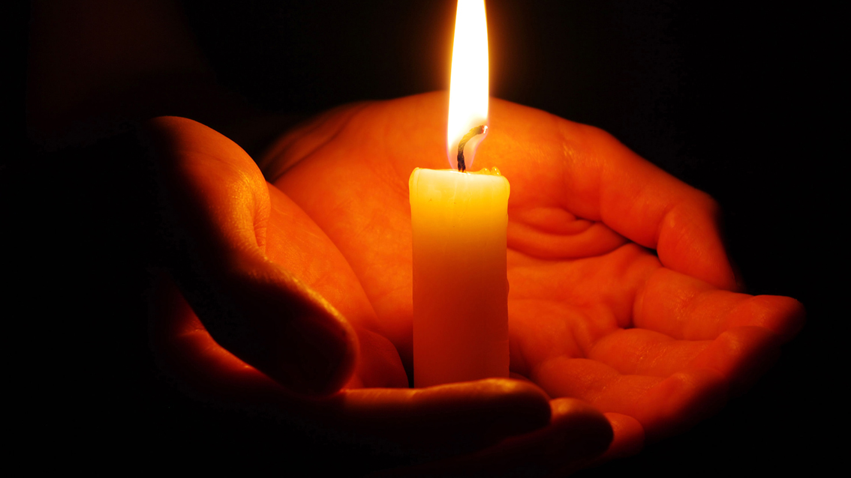
God Almighty, shaper and ruler of all creatures, we pray for your great mercy, that you guide us towards you, for we cannot find our way. And guide us to your will, to the need of our soul, for we cannot do it ourselves. And make our mind steadfast in your will and aware of our soul’s need. Strengthen us against the temptations of the devil, and remove from us all lust and every unrighteousness, and shield us against our foes, seen and unseen. Teach us to do your will, that we may inwardly love you before all things with a pure mind. For you are our maker and our redeemer, our help, our comfort, our trust, our hope; praise and glory be to you now and forever. Protect us, God, as we stay awake, watch over us as we sleep; that awake we may keep watch with Christ, and asleep rest in His peace. Amen.

